Slide 1
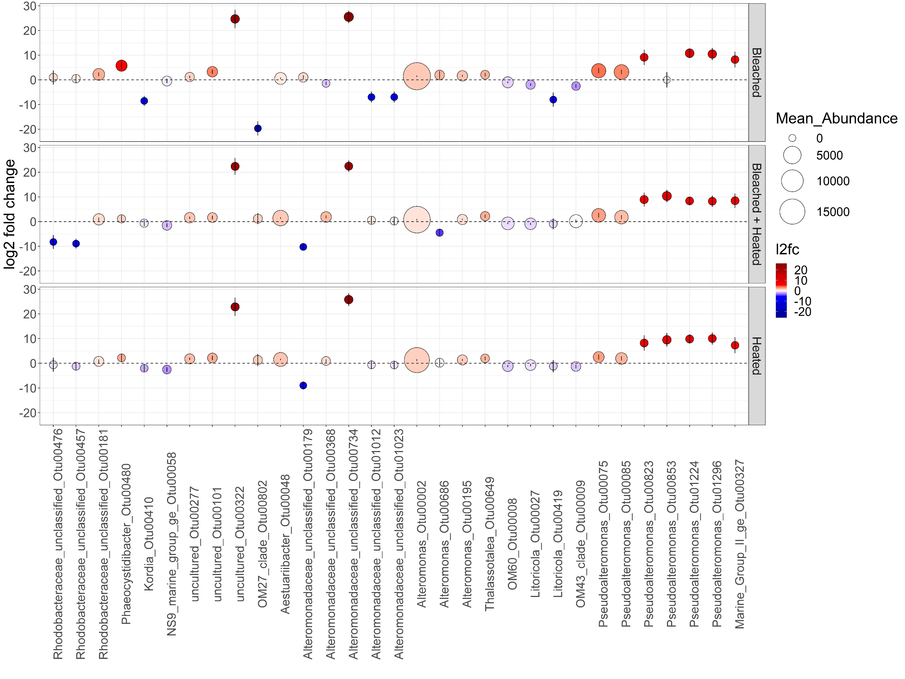
*
*
*
*
*
*
*
*
*
*
*
*
*
*
*
*
*
*
*
*
*
*
*
*
*
*
*
*
*
*
*
*
*
*
*
*
*
*
*
*
*
*
*
*
*
*
Alphaproteobacteria
Bacteroidia
Deltaproteobacteria
Gammaproteobacteria
Thermoplasmata

